Slide 1
JEAN-YVES LEROUX

Slide 2
Medelys offering
Distinctive position in the marketplace
target niche segment of the market.
position our products in categories that help the body’s own repair mechanism to heal itself.
The products ingredients influences the metabolic pathways
sustainability with time (targeting long term effect)
Medelys products can be used as
complementary products to the actual therapeutic approaches
or
alternative for the long term because of their low secondary/toxicity profile and their preferred mechanism of action (metabolic vs pharmacologic).

Slide 3
Medelys FAQ
How important are the types of collagen? how does this matter?
What is hydrolysed collagen means?
Is fish collagen better than bovine or porcine collagen?
How should I present the collagen based products to the customers?
New generation of “gluco/chondro” supplement
Collagen in its hydrolysed form is totally absorbed
Collagen represented the major and the most important molecule to support connective tissues

Slide 4
Medelys product categories
Joint and physical pain ( Supreme Collagen, Medlaid, Med-flex.. )
Targeting 5 M Canadians/ 50 M Americains with osteoarthritis
Health and beauty ( Nutra Collagen, Serum*… )
Targeting all women/ younger men
Immunity ( Ionized Silver, … )
Targeting the population in general
Active life ( Nutra Drink, Energy Drink*, Recovery Drink*…)
Targeting ¼ of Canadians

Slide 5
Collagen platform
Joint, bone & muscular health
Pain
mgnt
Wound healing
Energy
&
Cardio health
Physical fitness
Graceful Aging
Targeted conditions:

Slide 6
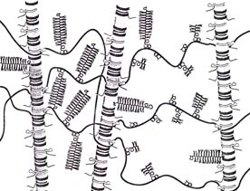
First part: the body matrix
The connective tissue matrix:
The cartilage extra-cellular matrix
The matrix
Collagen:
Unique Biochemistry: 19 amino acids (Hx-proline and Hx-Lysine)
Different types of collagen: thirty and more
Proteoglycan:
Unique composition of protein and complex carbohydrate
(Chondroitin sulfate)
Hyaluronic acid (HA)
(Glucosamine)
Structural function
Bio-mechanical, resistance to forces (shearing, compression)
Proteoglycan
P
O
O
L
E
1
9
9
4
Joint Cartilage:
FIBRILLAR COLLAGEN: ~ 67%
CHONDROITIN SULFATE : ~2 À 5%
GLUCOSAMINE: ~0.5 À 1 %
Collagen
(HA)

Slide 7
The technology
Where do we find collagen in the body?
Skin: 90% (prot. Derma)
Bone: 25-50%
Cartilage: 66%
Ligaments > 60%
Tendons > 85%
Muscles (envelop)
Internal organs
Connective tissues
Blood vessels

Slide 8
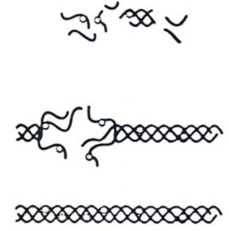
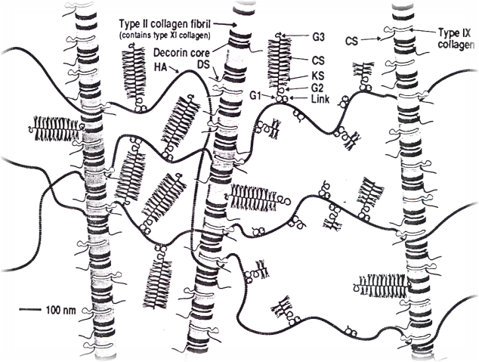
THE CONCEPT BEHIND MEDELYS
NUTRA & SUPREME COLLAGEN FORMULAS
REBUILD
CONNECTIVE TISSUES
Properly selected
BASIC ELEMENTS
From the hydrolysed building blocks
of collagen and glycoaminoglycan
the cells of any connective tissues
will make the right type of collagen
that the tissue needs (i.e. coll. 1 to 30)
Skin, bones, cartilage, tendons, ligaments…
Metabolic stimulation
Cell
Neosynthesis
COLLAGEN FIBRILS
COLLAGENOUS
MATRIX

Slide 9
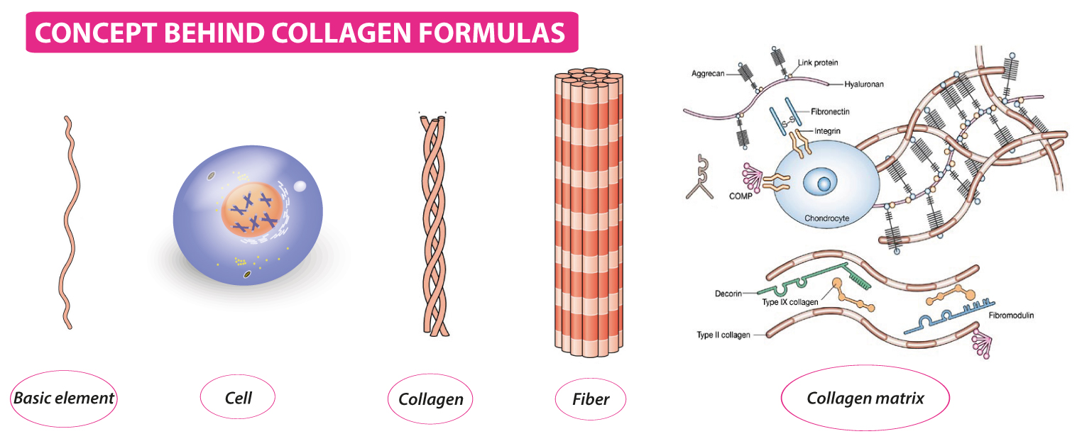
Third part: Hydrolyzed collagen
Treatment and prevention

Slide 10
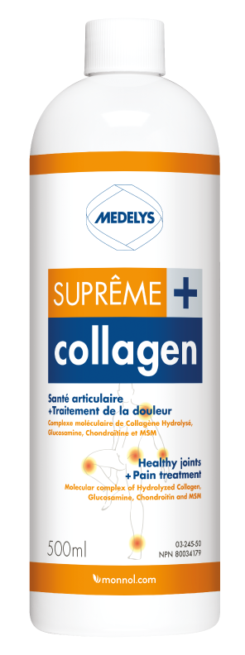

Slide 11
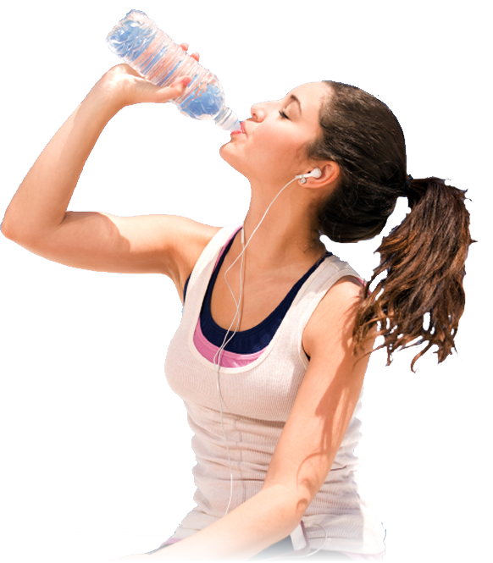
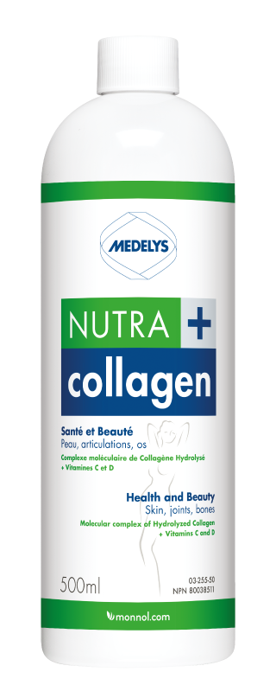
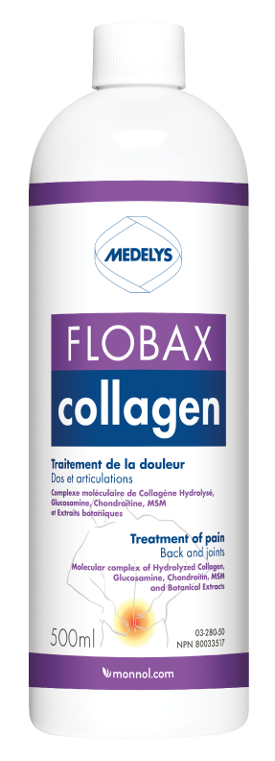
MEDELYS Hydrolyzed
Collagen for prevention and
treatment of joint diseases

Slide 12
Nutra Collagen +
Stimulates skin regeneration
Helps attenuate wrinkles
Tonifies and increases skin elasticity
Advantages
Liquid for optimal dosage
Highly concentrated in active ingredients
No side effects

Slide 13
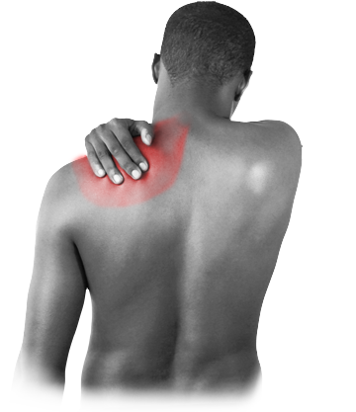
SUPREME Collagen +
Repairs and regenerates joint tissues
Soothes joint pain
Prevents excessive wear and tear
Advantages
Multiple ingredients formula
Highly concentrated in active ingredients
Liquid for optimal dosage

Slide 14
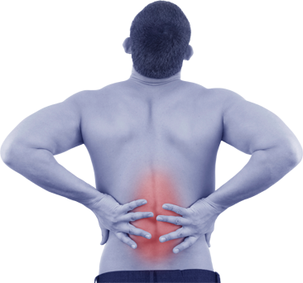
Flobax Collagen
Relieves back pain
Helps repair back joints
Treats inflammation of the joints
Advantages
Multiple ingredients formula
Highly concentrated in active ingredients
Liquid for optimal dosage

Slide 15
Improvement
Improvement
Improvement

Slide 16
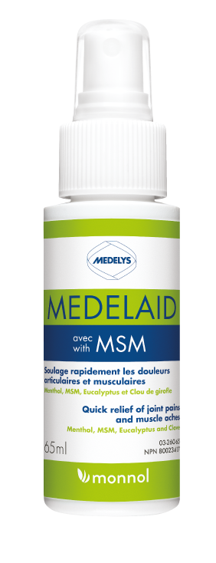
Medelaid
Topical Analgesic With a stronger anti-inflammatory action (MSM)
MSM: anti-inflammatory & analgesic
Menthol: refreshing, analgesic (rec. Opioide, Ca++), anti-spasmodic
Clove oil: analgesic & anesthesiant
Eucalyptus oil: analgesic, muscular relaxant, soothing, eases healing
Advantages
Removes inflammation
For immediate relief of muscular and joint pain
Relaxes your muscles

Slide 17
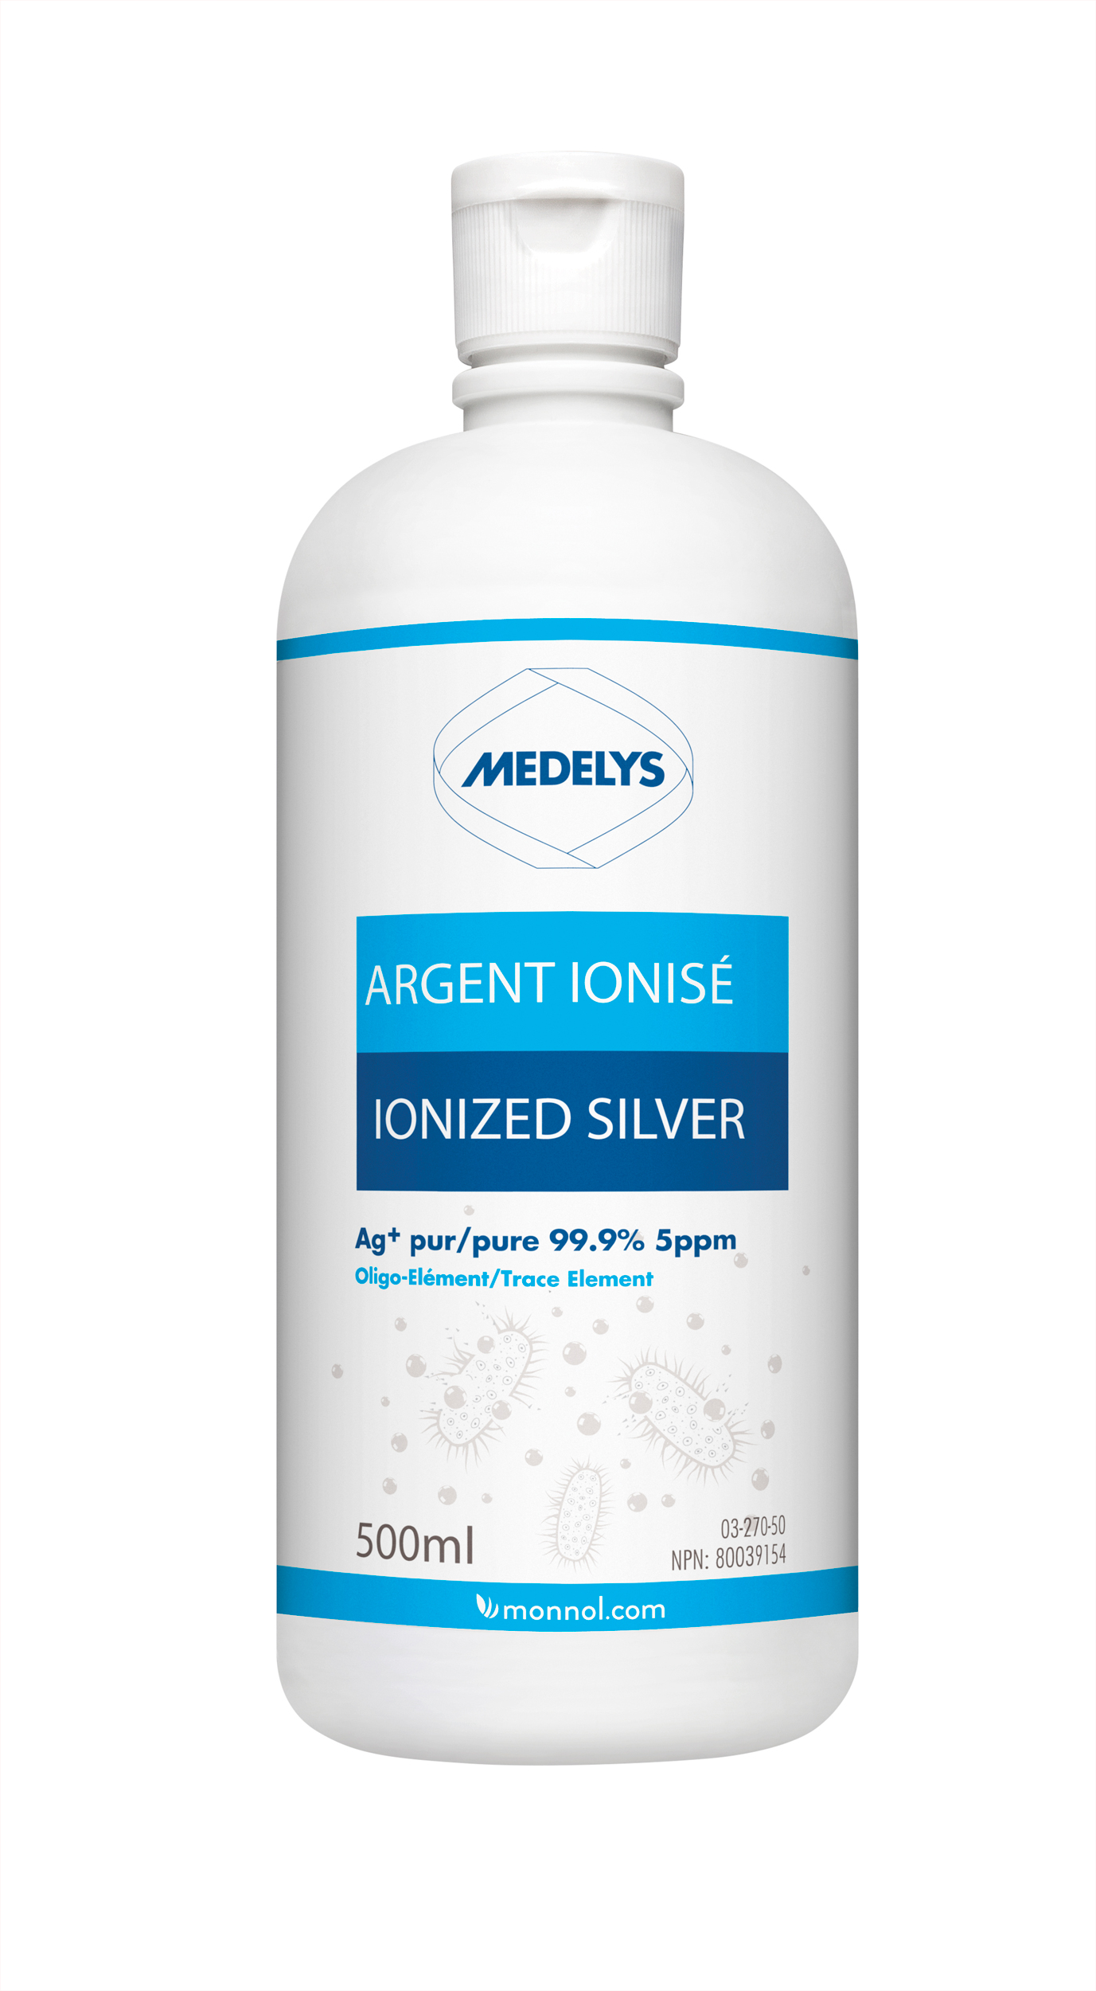
Usage
How to use ionic silver
Acceptables usages: prevent bacterial growth and minor infections
Actual Status
Adjuvant
Caution: use for short term
Topic & oral: why & how

Slide 18
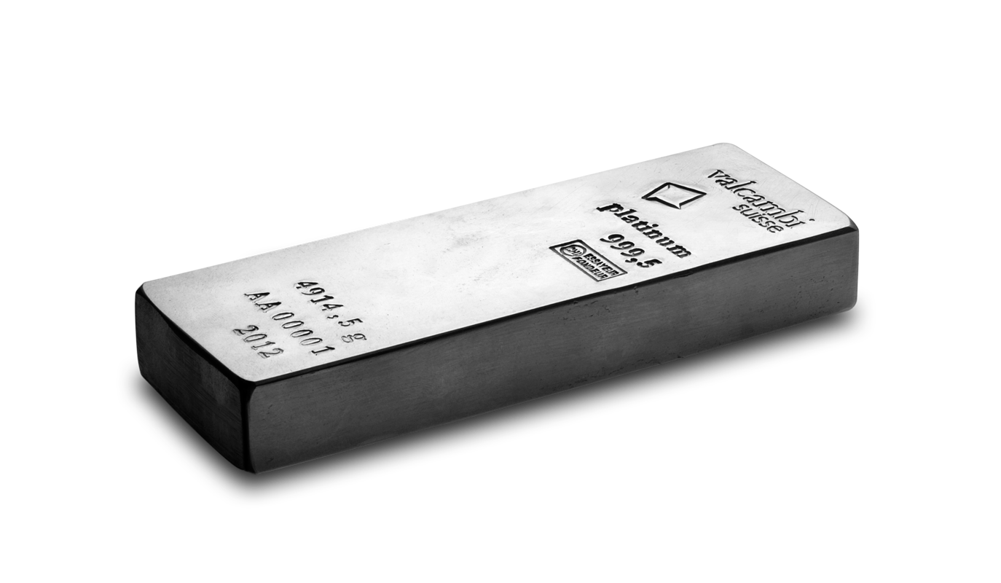
Mechanism of Action
Elucidation of its mode of action
Oligodynamic Principle
The silver ion Ag + is at the center of the mechanisms of antibiotic action of the silver and this for all the forms
Whether it is a salt, a protein or a silver colloid: silver ion release = capture and accumulation on and in the microbe (concentration from diluted solution)
Estimated: 100 000 atoms Ag + kill 1 bacterium
1 ppm of silver (totally in its ionic form Ag+)
Equals 1 mg per liter (Ag = 108g / L = 1 M = 6,023 X 10 23 atoms) or 5.09 X / 10
16 atoms (10 million billion killing 10 trillion bacteria)

Slide 19
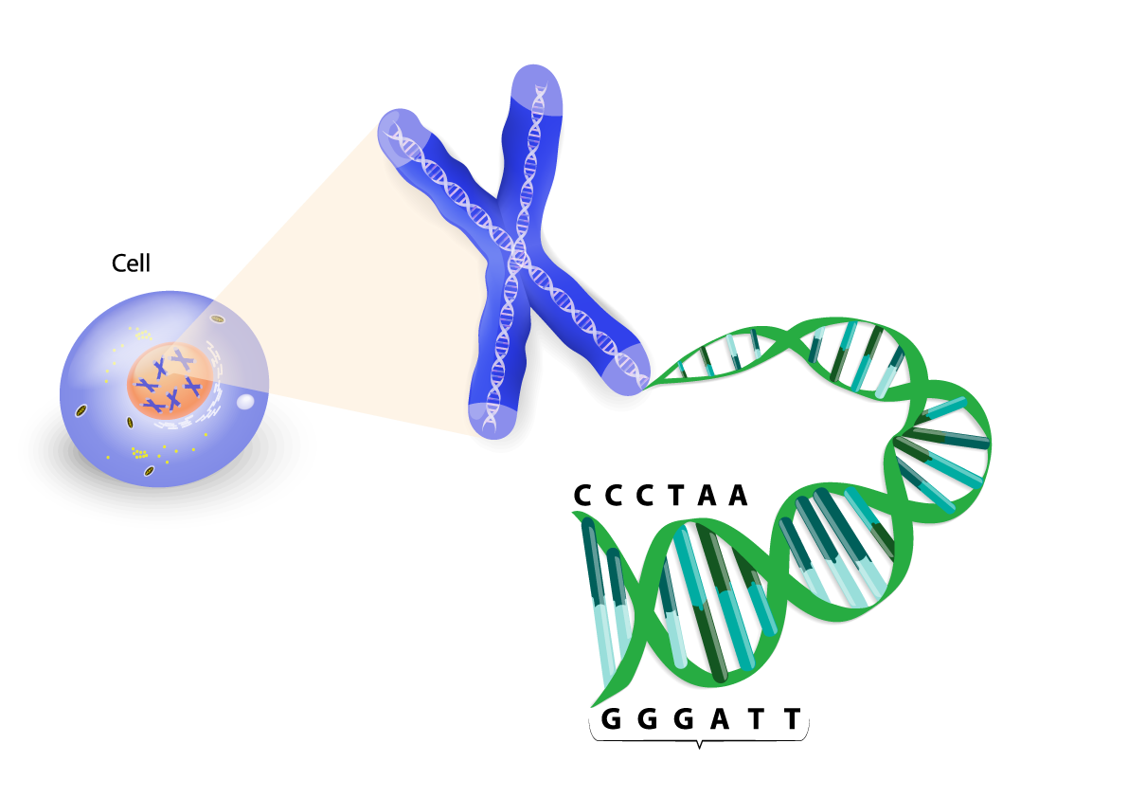
Mechanism of Action
Elucidation of its mode of action
Oligodynamic principle accumulation in microbes
Three pathways of voie destruction:
Cell membrane disruption
Protein and enzyme entering cellular respiration blocked
Intercalation DNA and RNA
In both cases the viruses are also affected.
The Ag + ion is highly reactive

Slide 20
Mechanism of Action
Differences between ionic and colloïdal silver
Colloïd: atome forming a metalic complex in suspension (non dissolve like a solution)
Colloïdal silver: leachs one ion with a global ionic positive charge
One ion Ag + (depending on its dissociation constant as a salt or a free ion without a contre-ion) is generaly in solution
For the same concentration or weight (10 ppm ou 10 mg/L) the Ag+ (ionique) solution offer more positive destructrice charge against microbe
Ag+ ion is highly reactive and obviously more efficient

Slide 21
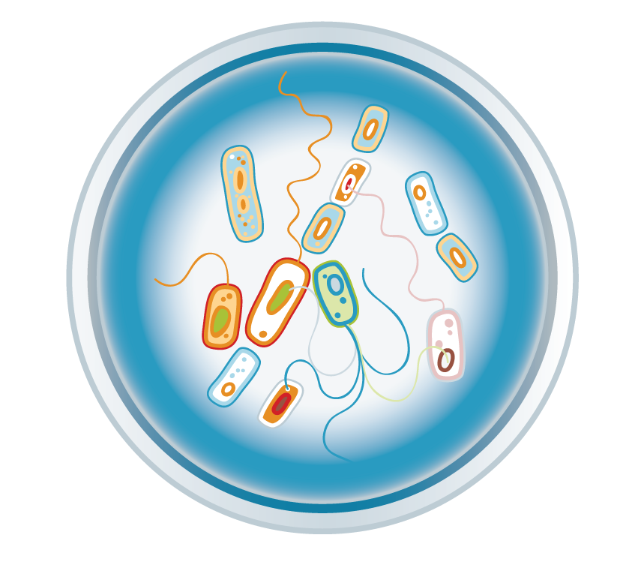
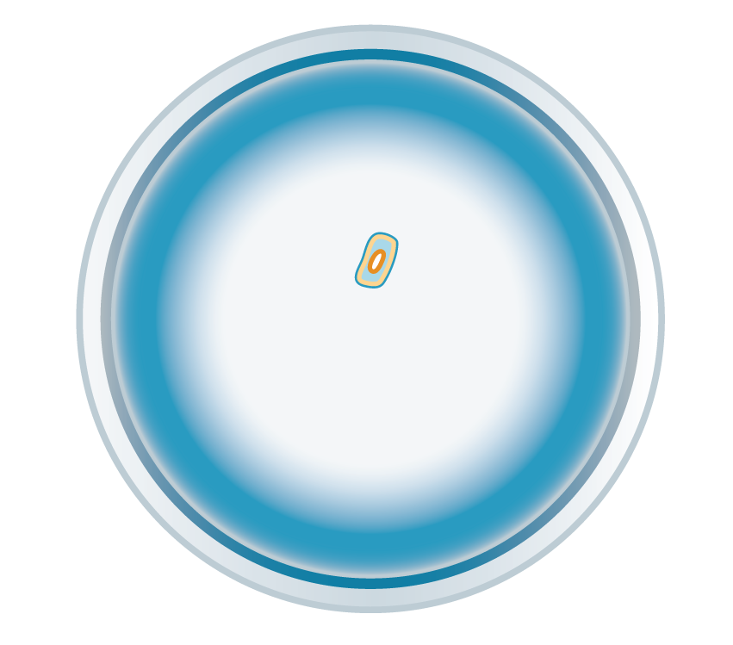
Action mx
Differences between ionic and colloidal silver
Colloïd
Ion
Destruction of bacteria

Slide 22
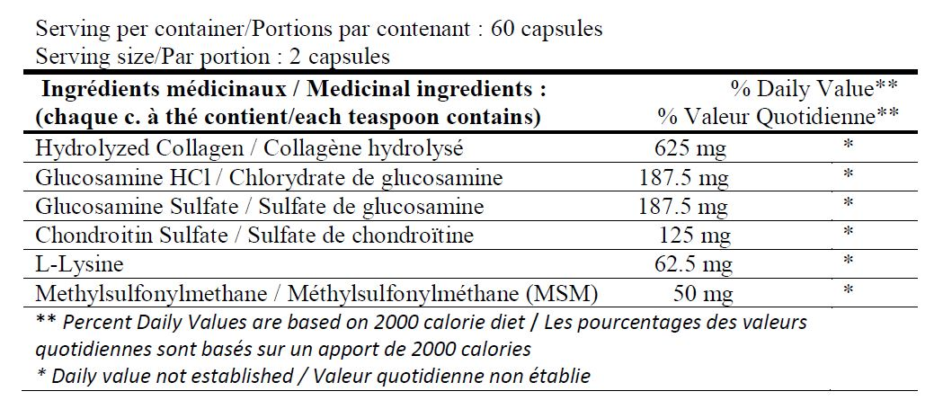
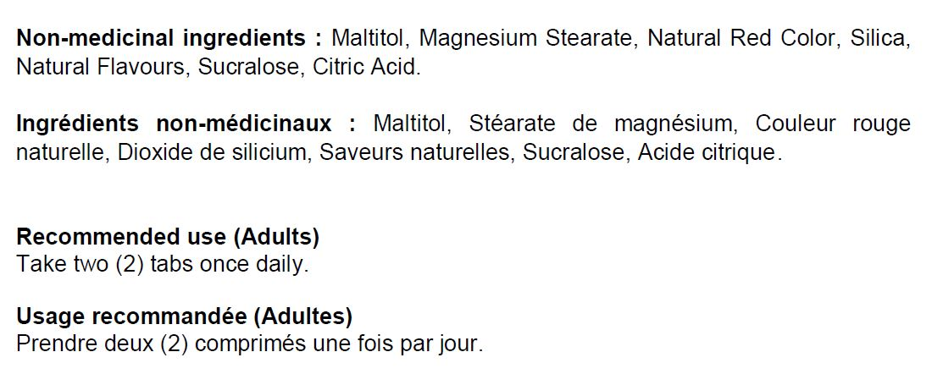
NUTRITION FACTS / FICHE NUTRITIONNELLE

Slide 23
SPECIFICATION SHEET (FINISHED PRODUCT)
PRODUCTION PARAMETERS
PACKING PARAMETERS

Slide 24
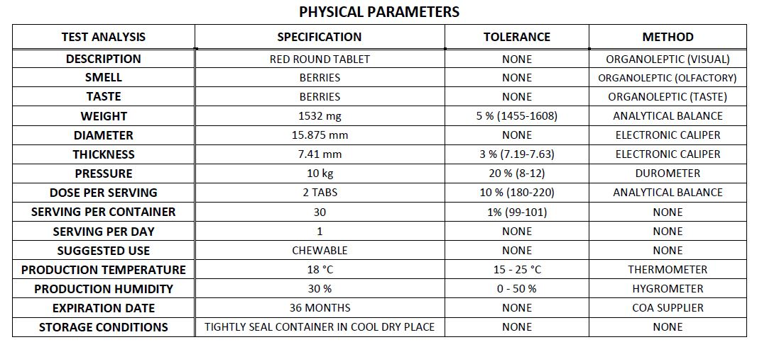
PHYSICAL PARAMETERS
INGREDIENTS DOSAGE

Slide 25
MICROBIOLOGICAL PURITY
CHEMICAL PURITY

Slide 26
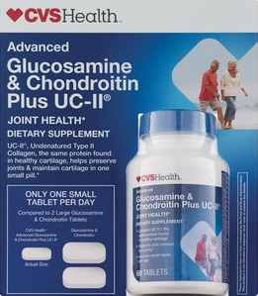
SUPPLEMENT FACTS
CVS Health Advanced Glucosamine & Chondroitin Plus UC-II Tablets
Serving Size: 1 tablet
Nutrient
Amount per Serving
% Daily Value
Chondroitin Sulfate
100 mg
Glucosamine HCl
125 mg
UC-II Standardized Cartilage (Providing 10 mg Undenatured Type II Collagen)
40 mg
CVS Health Glucosamine & Chondroitin Plus UC-II contains undenatured type II collagen, which is the same protein found in healthy cartilage. Cartilage-derived type II collagen is preserved intact using a patented stabilization process. This helps preserve joints and maintain in one small pill.

Slide 27
SUPPLEMENT FACTS
CVS Health Triple Action Joint Health Tablets, 30CT
Serving Size: 1 tablet
Nutrient
Amount per Serving
% Daily Value
Hyaluronic Acid
3.3 mg
Boron
5 mg
UC-II Standardized Cartilage (Providing 10 mg Undenatured Type II Collagen)
40 mg
CVS Health triple action joint health is a combination of three important nutrients that help promote joint, bone and cartilage health. UC-II collagen with undenatured type II collagen is the same protein found in healthy cartilage. Via a patented stabilization process, the cartilage-derived type II collagen is preserved intact.

Slide 28
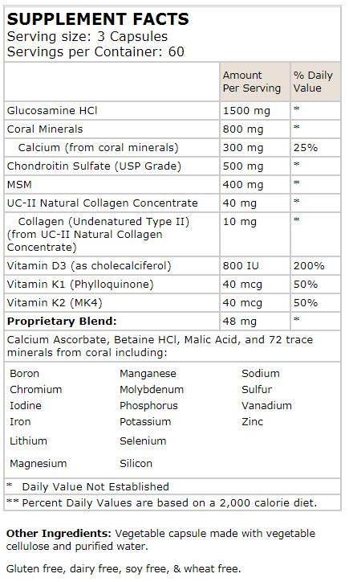
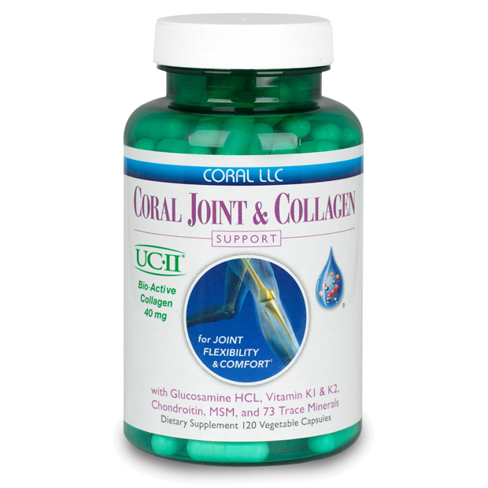
SUPPLEMENT FACTS
Coral Joint & Collagen Support 120 Vegetable caps

